Slide 1
Java - Tetris
Group 3
408850381 徐雅玟 / 408850385 鄭明佐

Slide 2
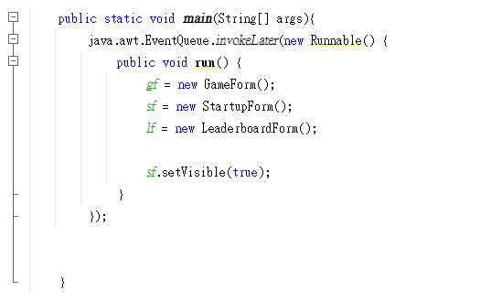
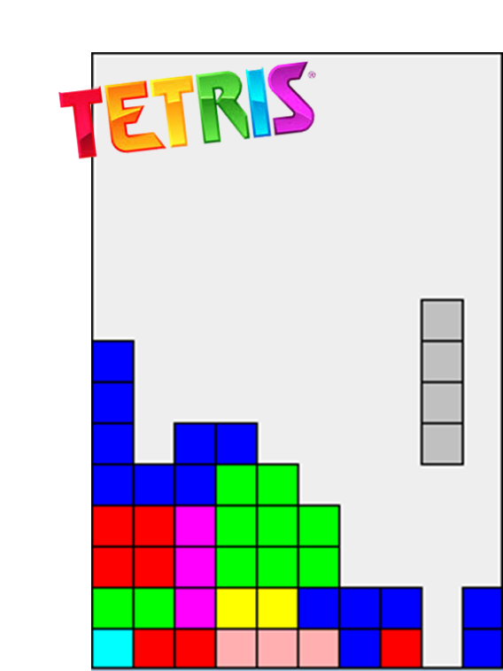
Main Function
- Startup Form
- Game Form
- Shape of block
- Move Block
- Game Over
- DataBase

Slide 3

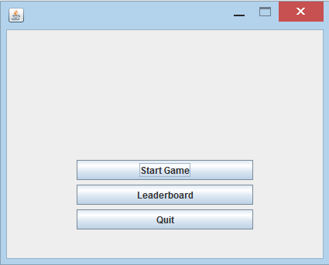
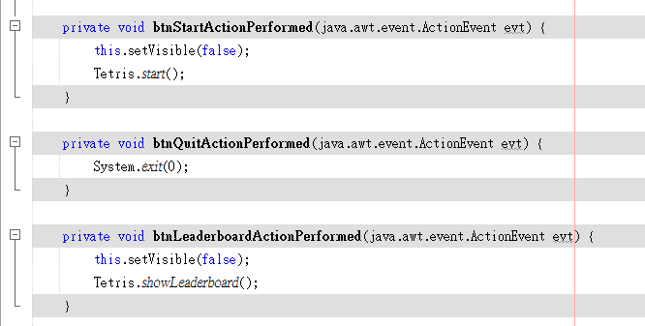
Startup Form
//…

Slide 4

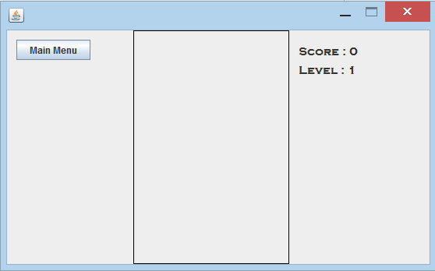
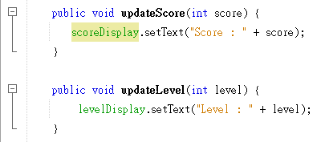
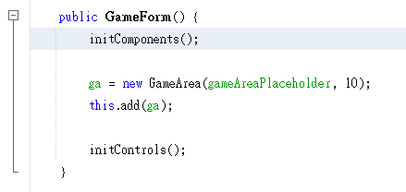
Game Form

Slide 5
Shape of Blocks

Slide 6
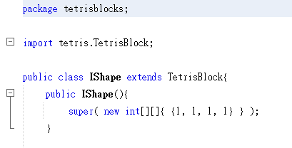
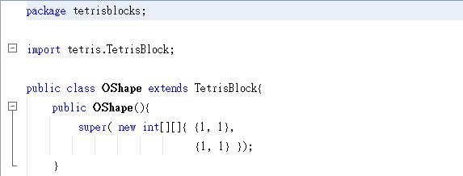
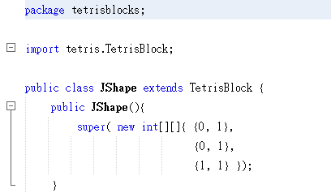
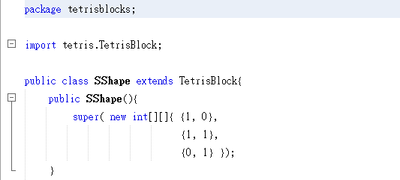
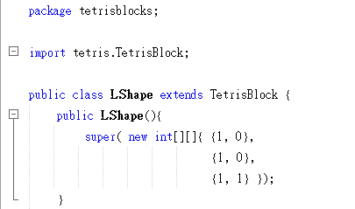
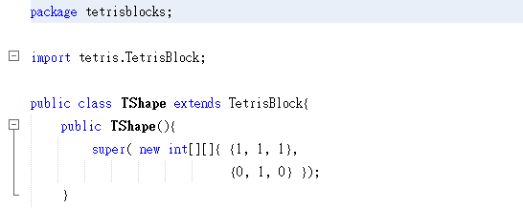
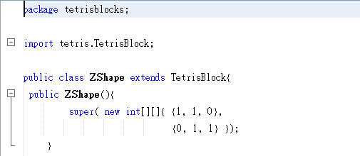
1 | 1 | 1 | 1
1 | 1
1 | 1
0 | 1
0 | 1
1 | 1
1 | 0
1 | 1
0 | 1
1 | 0
1 | 0
1 | 1
1 | 1 | 1
0 | 1 | 0
1 | 1 | 0
0 | 1 | 1

Slide 7
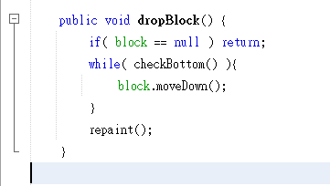

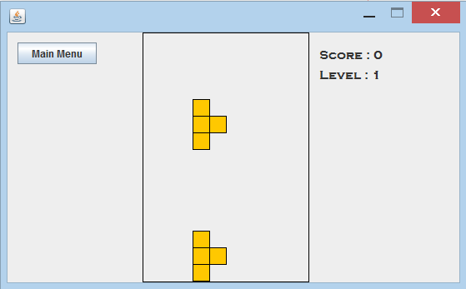
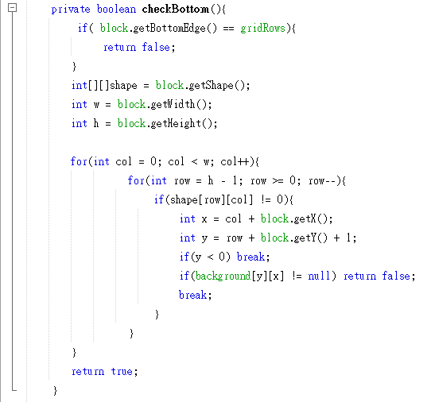
Game Form
//Game Area.java
//let block move down
//Tetris Block.java
stop

Slide 8
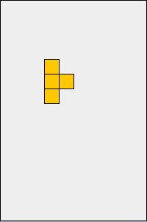
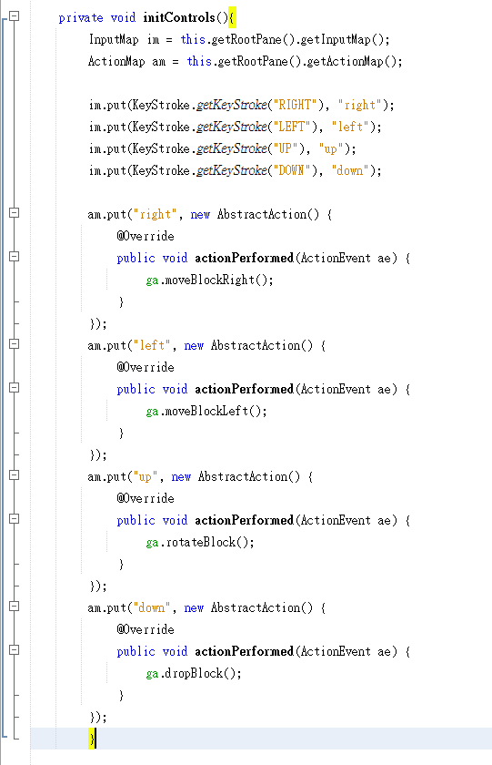
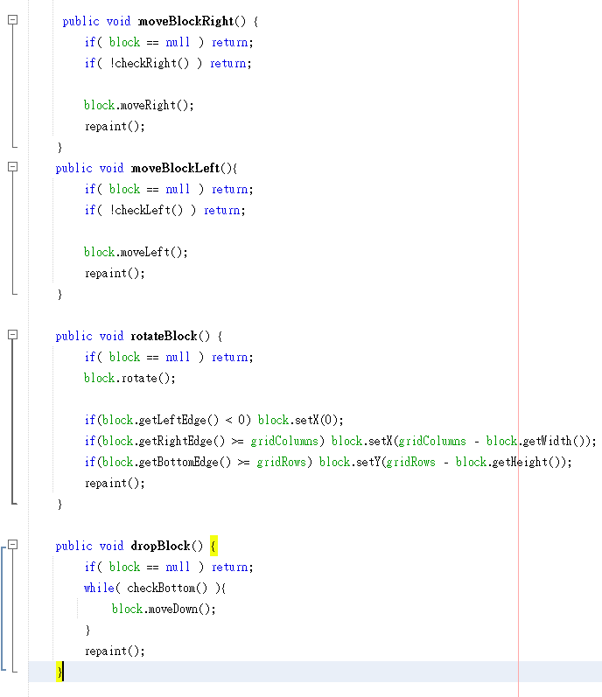
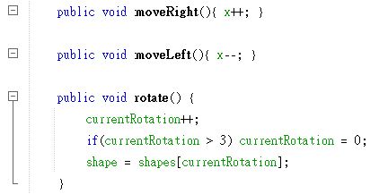
Move block
y
//Game Form.java
//Game Area.java
x

Slide 9

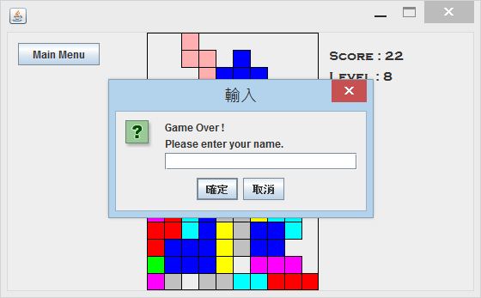
Game Over
Input and Output your name(data)

Slide 10
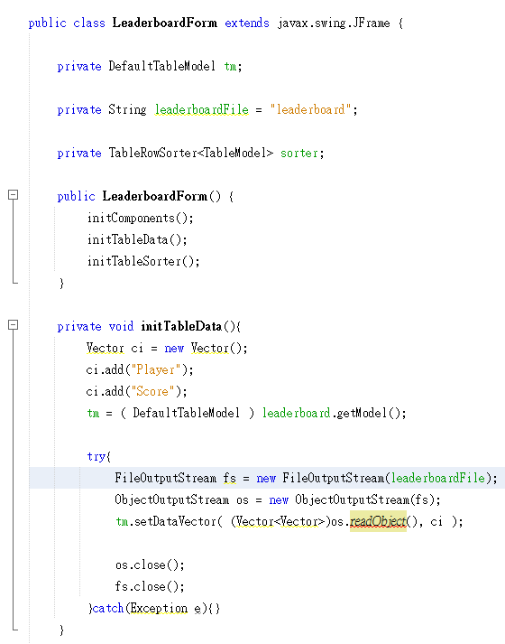
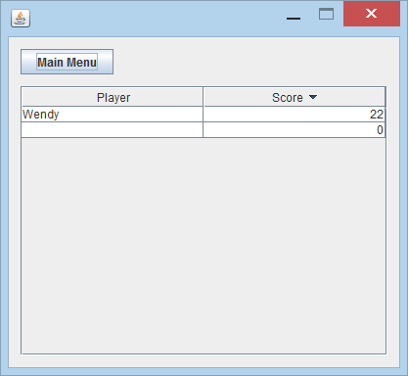
Leaderboard Form

Slide 11
DataBase
Read the Files(Add music)

Slide 12
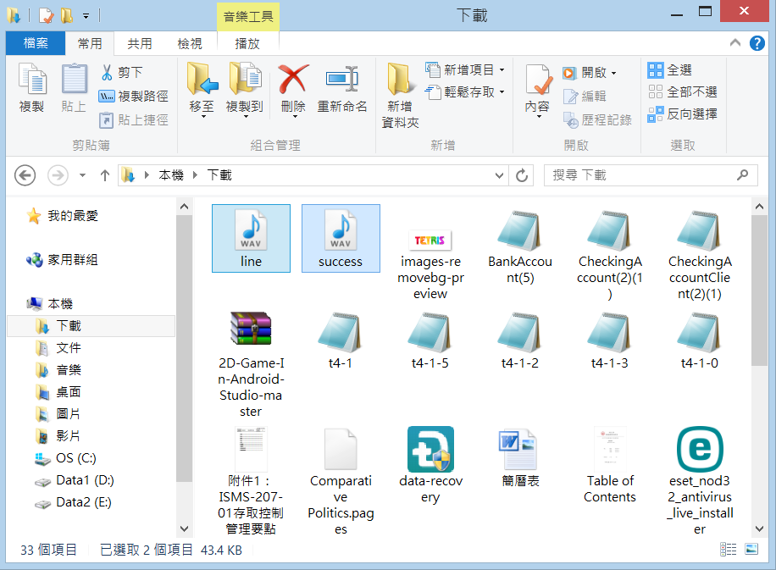
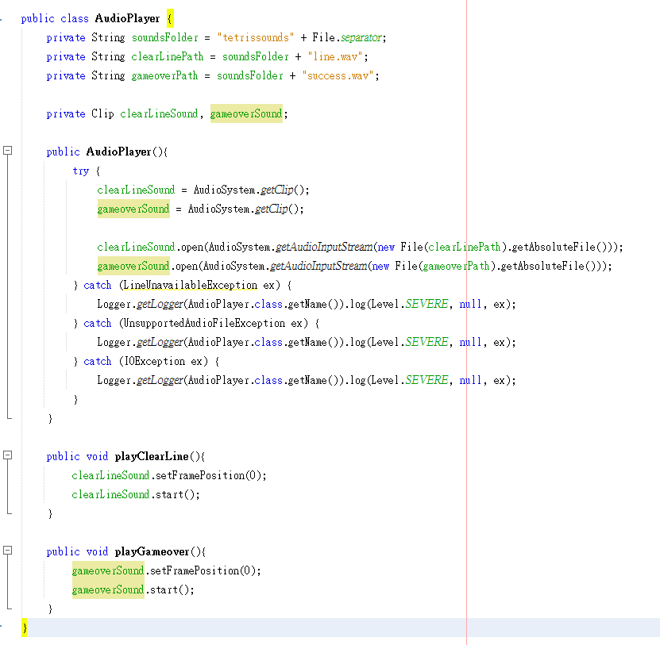

//Audio Player.java
//Tetris.java

Slide 13
Thanks for your listening

